Slide 1
Java SE
Standard Edition
Notes:
Introduction
Rules
Expectations
JVM – what is Java – why do we use it?

Slide 2
Variables & Methods
Variables
A variable is a container that holds values that we use in the program.
Every variable has a data type and a name associated with it, and eventually, a value.
A variable could be declared to use one of the eight primitive types
Methods
A method is a set of code which is referred to by name and can be called at any point in a program by simply utilising the methods name.
Think of a method as a sub-program that acts on data and often returns a value.
Every method has a name and a return type, and can also have parameters that are variables that you give it that it may need to perform its function.
Notes:
There is a difference between methods and functions
Functions are stand alone – Methods are attached to a class
We use methods because we might want to repeat ourselves and use the code again
When discussing variables it is important that we mention the data types that we have, for example int, double, boolean and char.

Slide 3
Naming Conventions
It is important to be aware of the naming conventions associated with a language when starting out.
Here are some key ones for Java:
No Spaces in Names
Classes begin with Capital letters (Pascal Case)
Methods and Attributes begin with Lower case letters
Methods and Attribute names are in Camel case
camelCase
PascalCase
Notes:
You might occasionally see SOMETHING, if done correctly the capitalisation refers to something that is Final.
116

Slide 4
Syntax
{ } – These are used to surround code blocks. This includes Classes, Methods, Conditionals and loops.
; - These are used to end a line of code
// - used to comment a line
(Comments are lines of code that are ignored by compilers that aid your code in readability, often explaining chunks of code)
/* */ - Used to surround comment blocks
/** **/ - Used to surround documentation comment blocks (Like JavaDoc)
( ) – Used to surround parameters and arguments
. – Used to access a variables methods and attributes.
Notes:
Generally whenever you create a loop or a method or a class we will wrap the code in curly brackets
This is used to surround code blocks.
Always match up
; are mandatory – but this doesn’t mean every line in your code, it does depend on what that line is doing.
// and /**/ are to create comments
Comments are ignored
What is JavaDoc?
Documentation that integrates with an IDE – example you might want to refer to a different method in a different file and Javadoc can help you by not having you to refer back.
When we are going to create or call a function – we have to use normal () –
. Notation – allows us to access things within the object after the dot. Often referred to as dot notation
116

Slide 5
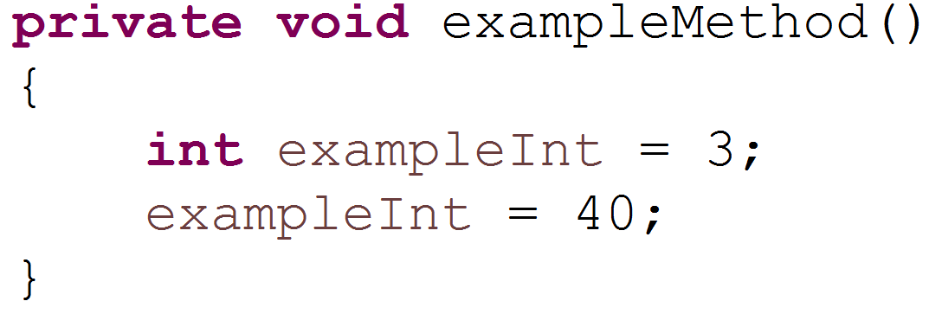
Examples
Access Modifier
Return Type
Method Name
Variable Name
Variable Type
End of statement
Assignment operator
Value
Notes:
The most common operator you’ll use in java is the assignment operator
“=“
Access modifier is something we’ll come onto soon.
Return type is what the method will give back when it is called, in this case, nothing. (void)
Method name is how we want to address this method.
Inside the method is an example variable declaration.
First is the type of the variable, in this case it is an integer (whole numbers)
Then is the name we want to address it by
Then we are assigning it the value of 3.
After that we can address the variable with its name, and perform actions on it, in this case we are then making it 40.
This is possible because it is being done within the same scope.
Private – denotes how accessible things are
Void – return type – functions can return data as well as accept data
The return type is where we signify the type of data that will be returned
Name – can be whatever but should be useful and make sense
() – parameters
{} – do we remember what these do? this is the method body
They only function when the method is called
When we are creating a local variable we cannot use it until we initialise it.

Slide 6
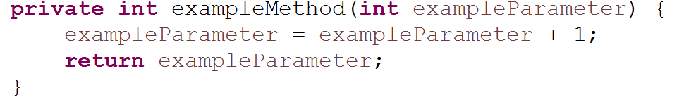
Examples – Parameters & Return
Access Modifier
Return Type
Method Name
First parameter variable type
First parameter variable name
Return keyword
Notes:
Another example method.
In this case we’ve changed the return type to int, so whenever this method is called it will return an integer.
It also has a parameter of type integer, so whenever we call this method we need to give it an integer to work with.
It then sets the parameter that we gave the method to a value
Then it returns the value.
Once a value is returned via the return keyword, the method ends, so any code after a keyword would have run can be treated as dead code
In an IDE this would be labelled as unreachable code.
This method will now return a parameter – it will give us something back.
Return keyword
If we are using a return type that isn’t void then we have to use this word
A method can only return 1 thing, that is one thing of the specified data type.
A method must return the data type specified and cannot return anything else.
System.out.println(); will be used a lot as you start to learn to code – it is how we will print things to the screen – or the console as it is called.

Slide 7
Example – The flow of execution.
public static void main(String[] args) {
method1();
method2();
System.out.println(method3());
}
static void method1() {
System.out.print("Hello");
}
static void method2() {
System.out.print(" World");
}
static String method3() {
return "!";
}
Notes:
Execution starts in the main method.
The first line of code is to call the method called method1
So then that method will be executed, which prints out
Hello
Then we go back to the main method, where now its at the line that executes method2
So then “ World” is printed
And on the third line in the main method it is encompassing it in a print line method itself, as method3() returns a string which we then want to print.
So “!” is printed
Could be the hardest part of java – if you cant follow your code logically you will struggle
How it jumps between certain methods.
Compiling it down into class files to give it to the JVM
We are saying run the main method in this file – its going to find the main method and will start executing the application
This is where all programs start and end??
Syntax is particular (has to have all these things – but we will look later)
The point is to show it is jumping around – but that it always comes back
116

Slide 8
Primitive Data Types
Data Type | Representation | Range | Default Value
boolean | n/a | true or false | false
byte | 8 | -128 to +127 | 0
char | Unicode | \u0000 to \uFFFF | \u0000
short | 16 bit | -32768 to 32767 | 0
int | 32 bit | -2147483648 to 2147483647 | 0
long | 64 bit | -922337206854775808 to 9223372036854775807 | 0L
float | 32 bit | 3.4e +/- 38(7 digits) | 0.0f
double | 64 | 1.7e +/- 308(15 digits) | 0.0d
Notes:
Note: You don’t have to initialize instance variables (belonging to class), but you do have to initialize local variables.
There are only 2 types of data, numeric and non-numeric data types
String isn’t technically a primitive data type, but it is often used like one.
Everything in java are based off of Primitive data types in one way or another
Boolean is appropriate for when you have 2 absolute values, either true or false, off or on, etc.
The bottom 5 are numerical data types – they just have a different size
Decimals are useful – obviously –briefly mention implicit casting
In reality performance is important but for everything we do here it isn’t so much
Char is technically a numeric data type – you may confused with this due to some wacky output
Its not about the shape of the data, it is about the nature of the data – this is in reference to the Numeric and non-numeric data types that we have previously looked at. A phone number might be in the shape of numbers but by nature it is not a number, it is a string.

Slide 9
Operators
Assignment
=
Arithmetic
+ Plus
- Minus
/ Divide
* Multiply
% Modulus
Unary
+ Indicates a positive value (Numbers are positive without it, too)
- Indicates a negative value.
++ Increments by 1
-- Decrements by 1
! The not operator - Inverts the value of a boolean
Notes:
Fairly obvious
++ and – and ! –
If you have a numeric data type like the ones on the previous page it will increment it by one
Very useful
Introduce i++ and ++i at this point
Both valid
Explain with sysout
All that really matters is that the are we going to use it and then increment it – or increment it and then use it
This is the basis of the entire thing

Slide 10
Operators - Example
int num = 0;
num = num + 1;
num = num - 14;
num = num % 29;
num = num / 900;
num = num * 34222;
num++;
num--;
++num;
num += num;
num -= 4;
num %= 232;
num /= 452;
num *= 1;
boolean b = true;
b = !b;
Notes:
int increment = 1;
System.out.println(increment++);
System.out.println(++increment);
1
3
116

Slide 11
Scope
Class Level/Instance Scope
Method/Local Scope
Loop Scope
Variables that are referenceable throughout the entire class, these methods are inside the class but outside of methods.
Generally defined at the top of the class.
Variables that are temporary and (generally) only used in the method they are declared in.
As soon as the method ends all variables declared inside that method are no longer referenced too and cannot be accessed any more.
Variables that are declared inside a loop declaration, only accessible inside the loop and are lost after the loop is ended
Notes:
116

Slide 12
Scope - Example
public class HelloWorld {
int n = n1;
int n0 = 0;
public void scope() {
int n1 = n0;
{
int n2 = n1;
}
int n3 = n2;
}
}
We can declare variables within any block
A block is begun with an opening curly bracket, and ended with a closing curly bracket.
One block is equivalent to One new Scope, every time you create a block (A class, a method, a loop, anything) you are creating a new level of Scope.
Scope determines what is visible to other parts of your program, and can also determine the lifetime of those objects
E.g. variables declared in a method are lost once the method is finished.
Notes:
Pick on trainees to answer this question
116

Slide 13
The Main Method!
public Indicates that the method can be called by any object
static Indicates that it is a class method. Which can be called without an instantiation of an object of the class (more on that later) This is used by the Java interpreter to launch the program by invoking the main method of the class identified in the command to start the program.
void Indicates that the method doesn’t return a value
String[] args An array of type string, which contains arguments entered at the command line
public static void main(String[] args)
{
}
Notes:
If you ever try to run your project and you get an error such as “main method not found”, it’s probably because you’ve not created your main method properly!
116

Slide 14
Static
Means ‘belongs to the class’
..as opposed to ‘belonging to an instance of the class’
Static members (fields and methods) visible via the classname
No requirement to instantiate the class, often a utility class
For instance System
Fine for the early days of coding and learning the basics
But when we have looked at OOP
We want to start saying objref = new ClassName() repeatedly
System.out.println();
System s = new System();
s.out.println();
Math.sqrt(25.6); System.out.println(Math.PI);
Math m = new Math();
m.sqrt(25.6);
Notes:
Use the banking example – explain that if you want to create a variable that will be shared across multiple classes then you should create a static variable
When you create an example that is thought and prepared then it is easier to answer questions.

Slide 15
Sequencing & Statements
Variables
Expressions
Assignment Statements
Variables as you know are where we store values
Expressions are what we write to compute new values from existing ones
Assignment statements are where we store values into variables
Conditional Statements
Iteration Statements
Transfer & Control Statements
Conditional statements are where code will only be run if a specified condition is met
Iterative statements are where a block of code is run multiple times until a conditional statement has been satisfied
These statements are used to interrupt and stop the normal flow of control.
Notes:
The top line are things we have already discussed.
The bottom 3 are what we will be moving onto.

Slide 16
Conditionals

Slide 17
More Operators
Equality
== - Is equal too
!= - Not equal too
< - Less than
> - Greater than
<= - Less than or equal too
>= - Greater than or equal too
Type Comparison
instanceof – compares an object to a specified type
Conditional
Logical
&& - and
|| - or
Boolean
& - and
| - or
Notes:
The difference between the single & and the double & (and | /or) is that with && / || it will only evaluate the second statement if it needs too, whilst & / | always evaluate the next statement

Slide 18
Conditional Statements – If/Else
If statements are used to run a block of code if the condition is met.
If the statement is true than the following code block will run.
If the statement is false than the code in the else block will run.
You can chain if - else statements to build more complex conditional statements.
boolean isDevCool = false;
if (isDevCool) {
System.out.println(“Dev is Cool");
} else {
System.out.println(“Dev isn’t cool.");
}

Slide 19
If/Else with logical operators
As you can see here we have made our If statement more advanced.
We are now capable of analysing this situation with an AND operator instead of requiring a second statement.
int devsMoney = 3;
boolean isDevDrunk = true;
if (devsMoney > 0 && isDevDrunk) {
System.out.println(“He will buy you drinks");
} else {
System.out.println(“He won’t buy you drinks");
}

Slide 20
If/Else/Else if with logical operators
As you can see here we have made our If statement more advanced, this time adding an else if statement.
This example now checks if dev has any money, and if he can play smash, if so then he can enter a tournament, otherwise other conditions might be met.
int devsMoney = 90;
boolean devCanPlaySmash = false;
if (devsMoney > 5 && devCanPlaySmash) {
System.out.println(“Dev enters a smash tournament");
} else if (devsMoney < 1 && devCanPlaySmash) {
System.out.println(“Dev is just too poor to enter");
} else {
System.out.println(“Dev just cant play smash");
}

Slide 21
Switch Statements
int day = 3;
switch (day) {
case 1:
System.out.println(“Garfield hates Mondays");
break;
case 6: System.out.println(“Saturday");
break;
case 7:
System.out.println("Sunday");
break;
default:
System.out.println("Not a day");
break;
}
Switch statements are vey useful for defined conditions and for when there are a lot of options that would cause if/else statements to become overly cumbersome.
Switch statements allow us to include a default clause for when no cases match the input.
Case 6: literally refers to what will happen when day == 6, this is not some ordering mechanism, neither do the case have to be in a specific order.
Notes:
You don’t have to use breaks, but once condition Is met it will run all the code below it if there is no break, this can be useful in some cases such as for an application that prints all the remaining days left in the week (till the weekend) depending on what day it is given, so if you gave it Monday it would print Tuesday Wednesday Thursday Friday, give it Wednesday it would print Thursday Friday, without breaks you could make it print like this using less code.
The keyword break is something that we will come onto shortly

Slide 22
Iteration
Notes:
116

Slide 23
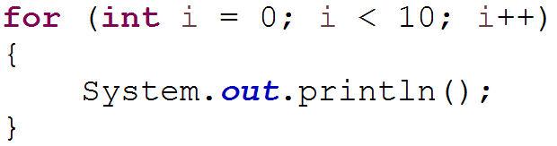
Iteration – For Loop
Initialisation
Exit condition
Update
Processing
Notes:
Initialisation can include a declaration, in this case we’re declaring an integer as i set to 0
The exit condition is when the loop should end, in this case it’s going to exit when i is equal to or greater than 10. aka “Run while this condition is true”
The change, in this case it’s incrementing i by one every iteration. This change happens at the very end of the iteration.

Slide 24
Iteration – While Loop
While loops check to see if the condition has been met and then run the code if not, checking the condition before each run.
int catCount = 0;
boolean notEnoughCats = true;
while (notEnoughCats) {
System.out.println("Another cat");
catCount++;
if (catcount > 273)
notEnoughCats = false;
}
System.out.println(“Gareth has too many cats");
Notes:
This is actually a poor example of a while loop as you could and should use a for loop.

Slide 25
Iteration – Do While
Do-While loops run a block of code before checking to see if the condition has been met, checking the statement after each run.
This loop should be used if you always want a block of code to be run at least once.
int playCount = 0;
boolean playing = true;
do {
System.out.println(“Playing");
playCount++;
//can only play 10 times
if (playCount > 10)
playing = false;
//or if you die
if (!isAlive())
playing = false;
} while (playing);
System.out.println(“Game Over!");

Slide 26
While - Example
Scanner sc = new Scanner(System.in);
boolean badInput = true;
int input = 0;
do {
System.out.println("Please enter a number");
try {
input = Integer.parseInt(sc.nextLine());
badInput = false;
} catch (Exception ex) {
System.out.println("Please enter a valid number");
}
} while (badInput);
System.out.println("Your number was: " + input);
Will loop and ask for user input until they input something that parseInt can successfully take, aka when they put in an integer.
Otherwise it will keep asking them for input.
It’s a do While because we want to ask them for input at least once.
It will escape the loop once it gets past the parseInt line and sets badInput to false, meaning on the next conditional check it will not pass and exit the loop.
Notes:
This slide should be skipped the first time through, it is a good example of a case where a while loop is necessary.
It is here to refer back too
116

Slide 27
Transfer and Control

Slide 28
Transfer & Control Statements
Break
Continue
Return
Break Statements break out of the current code block.
In loops this means that they will skip the rest of the loop and move onto the rest of the code.
Continue Statements break out of the current iteration of a code block.
In loops this means that they will skip to the next run of the loop.
Return statements are used in methods to return values according to the methods return type, ending the method.
Notes:
Break can be a bit unpredictable and hard to follow from an outside perspective, for this reason it is best to use it sparingly, for the purposes of this week it will rarely be necessary outside of a switch statement.

Slide 29
Transfer & Control Statements - Continue & Break
for (int i = 0; i < 10; i++) {
if (i == 7)
break;
if (i == 2)
continue;
System.out.println(i);
}
0
1
3
4
5
6
Notes:
If i is two, it skips the println statement, if its 7, it stops altogether.
Note: Use breaks in loop sparingly, think if your loop might be better as a while loop before using a break in a for loop.

Slide 30
Setting up your Environment

Slide 31
Setting up your environment
The JDK you will need can be found in:
This PC > Local Disk (C:) > LocalInstall > SDK
Eclipse can be found in:
This PC > Local Disk (C:) > LocalInstall > Editors
You will need to ‘Extract’ the folder here, you can then run the Eclipse.exe from the new Folder.

Slide 32
Setting up your environment
To get started working with Java you will need 1 thing:
The Java Development Kit (JDK)
This has everything you need to develop java applications.
So we’ll be using Eclipse mainly. (Feel free to use another IDE if you prefer)
Once you have the JDK there are a few steps you need to follow:
Install the JDK
Prepend C:\Program Files\Java\jdk…\bin (your path that you installed it too) to the beginning of the PATH variable
Enter java –version into command prompt to check that this has worked.
Install the IDE (Eclipse)
Notes:
JDK Exists in local install, as well as Eclipse.
Error 1 / virtual box not found = paths/environmentvariables are wrong or jdk/jre isn’t installed
Error 13 – need to edit .ini file, find the javaw.exe file in the jre folder, in the ini file, before vmargs type on a new line –vm NEWLINE JAVAWPATH

Slide 33
Creating your first project
The first thing to do is to make a project.
Eclipse has a wizard for creating new projects which makes this a very simple process.
Go to: File > New > Project… > Java Project
Enter the name “HelloWorld” and select Finish
You should now see your empty project in the package explorer.

Slide 34
Creating your first class
Now that we have our project lets create our class.
Right click on your project and select New > Class
Enter the name “HelloWorld”, select public as the modifier, ensure that the main method remains checked, and uncheck anything else.
This will add a new file to your project called HelloWorld.java
public class HelloWorld {
public static void main(String[] args) {
}
}
Notes:
If you open this file it will contain two lines of code.
The first line is the class declaration.
The second closes the class.
All code for this class goes between these two lines.
“main” is the method that is run when we start the program.
This is where execution begins, and ends.
We only make one of these methods in each project.
You’ll come to learn what public static void and the parameters mean later on, just know that the main method has to adhere to this structure otherwise java won’t be able to find it.
So if you’re writing your own main method manually, make sure it adheres to this.

Slide 35
Your first class
In the methods braces we will write the code for this method.
System.out.println() will print text to the console when we run the code.
Within the quotes we will write the message to be displayed.
When run this program will now execute this line of code, printing “Hello World!” to the screen.
public class HelloWorld {
public static void main(String[] args) {
System.out.println("Hello World!");
}
}

Slide 36
Useful Eclipse Shortcuts
CTRL + N – Create a new Project
CTRL + SHIFT + N – Create a new file (e.g. class)
CTRL + Q – Jump to last location edited
CTRL + . - Jump to next syntax warning/error
CTRL + SHIFT + P – Jump to matching bracket
ALT + UP/DOWN – Move current line
CTRL + H – Search Workspace
CTRL + SHIFT + O – Import missing libraries
CTRL + SHIFT + F – Format Class
CTRL + SHIFT + / - Add block comment around selection
CTRL + SHIFT + \ - Remove block comment around selection
ALT + / - Word completion
ALT + SHIFT + R – Rename selected element and all references of that element
CTRL + F11 – Save and launch application
sysout + CTRL + SPACE – Writes “System.out.println();”
Source->Generate getters/setters/toString()/Constructors
Notes:
Total list - https://www.shortcutworld.com/en/win/Eclipse.html
116

Slide 37
Arrays

Slide 38
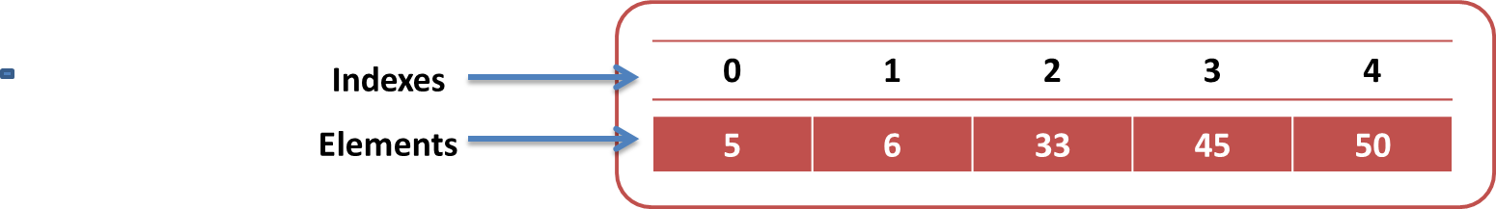
Arrays – Single Dimensional
Arrays are used for holding a collection of data. Different types of Arrays and Collections are intended for different situations.
One way to create an array is to use a set of square brackets:
int[] arrayOfInts = {5,6,33,45,50};
You can specify the length by putting the length in square brackets when instantiating the array:
int[] arrayOfInts = new int[5];
You can assign values directly to an index by specifying the index in square brackets: arrayOfInts[3] = 45;
Notes:
Very important to mention at this stage that arrays are of a fixed size, you cannot add or remove indexes at a later date.
The bottom example is how to access a specific element of the array.
Arrays start from the zeroth.
0 index based
Technically 3 ways of creating an array
Mention new keyword
How to access a particular element

Slide 39
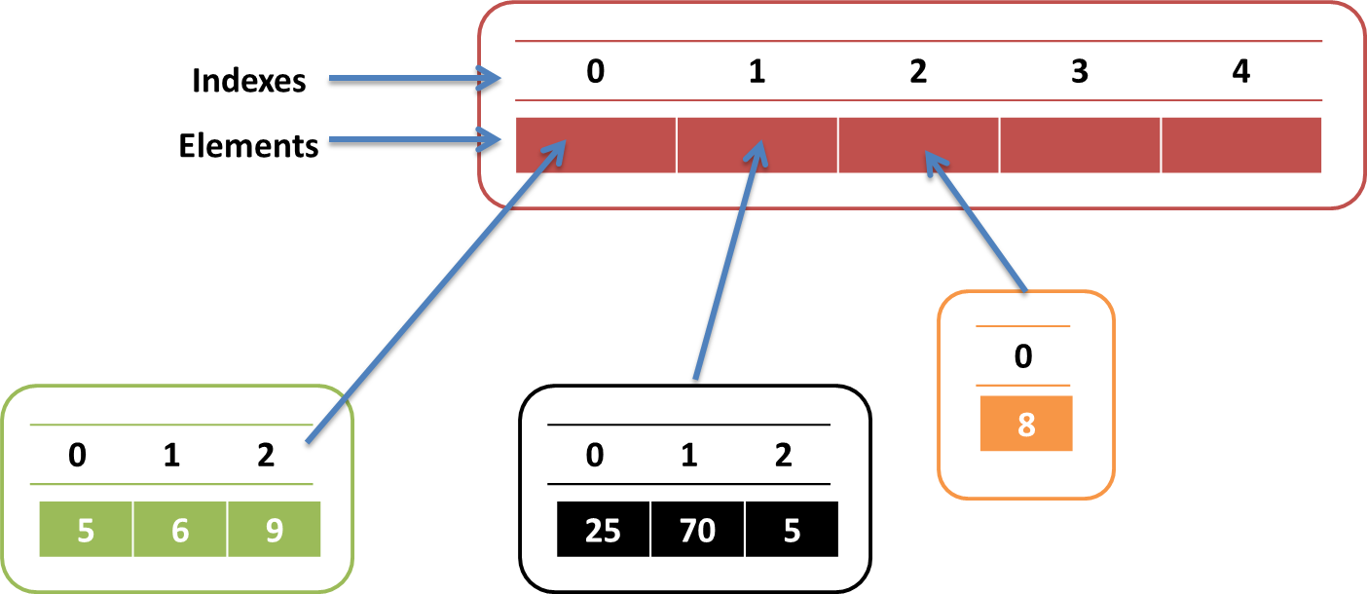
Arrays – Multi-Dimensional
These are arrays where each index of an array holds another array.
These can be specified by having two sets of square brackets:
int[][] multiArray = {{5,6,9},{25,70,5},{8},…};
You can specify the length in the same way as in single dimension arrays:
int[][] multiArray = new int[3][2];
You can assign values to an index by specifying both indexes:
multiArray[1][2] = 5;
Notes:
Show a simple loop through a 2d array that loops through the first element – explain how this looks and how it works
Explain going through the rows and the columns
Then move onto the way that the second value changes the column of the row
Explain the fact that within the second for loop we are moving through the twoDArray[i].length
Proper way of iterating through a 2d array
Explain how many times each loop is executed
twoDarray[i] refers to each row – the [j] effectively refers to the column / value in that row

Slide 40
For each Loop
For-Each loops iterate through each element in an array or collection.
This is a much tidier version of what regular for loops can achieve, both have their pros and cons.
“For every integer i in num, do x”
int num[] = {1, 2, 3, 4, 5, 6, 7, 8, 9, 0};
for (int i : num) {
System.out.println("Number: " + i);
}

Slide 41
For/For each - example
Access array elements by iterating (looping) over them
The first element is [0]
But often you just want to READ ALL of them
And do the same thing to each of them
for (int i = 0; i < votes.length; i++) {
process(votes[i]);
}
for (int vote : votes) {
process(vote);
}
Notes:
Both of these loops do the same thing, however one has a count of which iteration you are in and the other doesn’t, so if having that current iteration is important, use the first!
116

Slide 42
Loops & Arrays - Example
int nums[] = {1, 2, 3, 4, 5};
for (int i = 0; i < nums.length; ++j)
{
System.out.println(“This number is: “ + nums[i]);
}
}

Slide 43
For/Foreach – Two Dimensional Arrays
int twoDArray[][] = {{0, 1, 2}, {1, 2, 3}, {2, 3, 4}};
// columns
for (int i = 0; i < twoDArray.length; i++) {
// rows
for (int j = 0; j < twoDArray[i].length; j++) {
System.out.print(twoDArray[i][j]);
}
// after each row, print a new line
System.out.println();
}
int twoDArray[][] = {{0, 1, 2}, {1, 2, 3}, {2, 3, 4}};
// columns
for (int[] a : twoDArray) {
// rows
for (int b : a) {
System.out.print(b);
}
System.out.println();
}
Notes:
Both do the same thing.
Output:
012
123
234
116

Slide 44
Loops & Arrays - Example
int nums[] = { 1, 2, 3, 4, 5 };
for (int i : nums) {
for (int j = 0; j < nums.length; ++j) {
if (nums[j] == i)
System.out.println("i :" + i + " j :" + nums[j] + " i and j are the same");
}
}
Notes:
i :1 j :1 i and j are the same
i :2 j :2 i and j are the same
i :3 j :3 i and j are the same
i :4 j :4 i and j are the same
i :5 j :5 i and j are the same

Slide 45
Imports - Scanner
You have used System.out.println() to output to the console
But does Java have a ‘System.in.readln()’?
If it did you could prompt the user – yourself – and use the typed reply
How do you convert the ‘String’ read in into an int if a numeric reply?
This is where class java.util.Scanner is very useful
Allows user to read values of various types
But you have to point the scanner at something – the console input
Known as System.in
import java.util.Scanner;
public class ScannerTest
{
public static void main(String[] args)
{
Scanner s = new Scanner(System.in);
System.out.println("What is your name?");
String name = s.nextLine();
System.out.println("What is your age");
int age = s.nextInt();
System.out.println("Hi " + name + ", next year you will be" + (age + 1));
}
}
Notes:
Some important issues and work arounds in these notes.
When using a mixture of nextLine and nextInt (or any other nextXX method you will encounter issues that makes it seem like it’s skipping it etc.
This is because nextInt (and the others) doesn’t consume the newline character , just the integer
So the next time you use nextLine it just consumes that character, not asking for your input again.
One workaround is to just use sc.next/nextInt/nextChar etc and never use nextLine, but if you need to take more than one word then .next() wouldn’t suffice.
The other workaround is to use nextLine for everything, and use the wrapper objects PARSE methods depending on what you want
e.g. int input = Integer.parseInt(sc.nextLine());
This will throw an error if what is inputted isn’t a string but it is easy to handle.

Slide 46
List Implementations
The List interface extends Collection.
Precise control over where in the list each element is inserted.
User can access elements by their integer index or via searching for elements in the list.
Provides a special iterator called ListIterator
Some List implementations prohibit null elements, some have restrictions on their type of elements
LinkedList is another commonly used implementation of List
ArrayList – Index based system
Linked list – Doubly Linked list system
Because of these systems they implement they have their own strengths.
ArrayList – Faster searching/Lower overhead
Linked list – Faster deletion/Insertion
Notes:
List is an ordered Collection
ListIterator allows for element insertion and replacement, bidirectional access in addition to the normal operations that the Iterator interface provides
The searching functions that List provides are extremely inefficient and should be used with caution.
Don’t assume just because List allows null elements that an implementation of List will as well.
ArrayList maintains an index based system for its elements which implicitly makes it faster for searching for an element in the list.
Linked list implements a doubly linked list system which requires the traversal through all the elements to search for an element.
Linked list stores extra information (positions/neighbour nodes) – High memory consumption
Linked list deletion only requires the change of the neighbour node pointers whilst array list requires all data to be shifted to fill the space.
Allow access to objects that are stored in them
Used to store data
Simple data structure
0 index based system
Talk about how when we delete something from an arraylist everything gets shifted down to fill the new gap has been made – hence the reason that it is slow at adding and removing – because it has to reindex itself eveytime
In a linked list everything effectively is linked to something else
Searching for things in a linked list is extremely slow
The benefit is with if you want to remove something
All it effectively has to do is change to references
The thing that pointed to it
And the other thing
Remember auto garbage collection
Remember the diagrams with the grid of circles for array list
And the circles linking to one another for linked list

Slide 47
List Implementations
The arrays shown previously have been primitive arrays.
Seeing as Java is an Object orientated language you will most likely need arrays that can store Objects.
The most common array you will use will be the ArrayList:
ArrayList<Object> objects = new ArrayList<>();
There are many other types of array such as the Map, Set & List which are each tailored to different scenarios.
Notes:
An ArrayList is a dynamic data structure, this means items can be added and removed at will, changing the size of your arraylist as opposed to normal arrays where you are stuck with a static initial size of your array.
If you know how many items you want to store, you use arrays unless you really need some specific functionality (which you could debatably create yourself) that arraylists offers or speed/memory efficiency is of major concern.
If not, use arraylists.
Lists allow duplicate values
Some of the commands are slightly different, .length is now .size
.get to get an element
.set to change an element (this will take 2 parameters)
116

Slide 48
Best Practices
Before we learn to write code in a new language, we should think about how we should write that code.
Best Practices encompasses many topics and can be quite daunting if you are new to Java.
However take a glance at the document so you are aware of some of the Best Practices you will need to follow in the future.
https://gist.github.com/Matt25969/15d71670cf9d7b717abcc66177714fe6
Notes:
116

Slide 49
Streams

Slide 50
Streams
They may sound similar to input and output streams but they are different.
A Stream is an abstraction, it is not a place where we can store information.
It does not hold data, but it can manipulate it.
Streams have effectively replaced for each loops in Java 8.

Slide 51
Streams
A Stream represents a pipeline through which the data will flow and also the functions that will operate on the data.
We can ‘raise’ a collection to a stream by calling the .stream() method on a collection.
Once we have done this we can call functions that will interact with the stream.
This will look like multiple methods being chained together.

Slide 52
Some Fundamental functions
Filter returns a new stream that contains some of the elements of the original.
It computes which elements should be included, think checking a condition.
In the functional style we don’t bother with ifs, we filter the stream and work only on the values we require.

Slide 53
Some Fundamental functions
Map transforms the stream elements into something else, it accepts a function to apply to each and every element of the stream and returns a stream of the values the parameter function produced.
This is the bread and butter of the streams API, map allows you to perform a computation on the data inside a stream.
FlatMap can work with other collections, for example if I am working through a stream of String[ ] then I will need to use flatmap to get the information from each of the String [ ].

Slide 54
Some Fundamental functions
Peek is mainly used for debugging purposes.
It enables us to look at what is happening in the stream as it flows from one point to another.

Slide 55
Some Fundamental functions
Reduce (also sometimes called a fold) performs a reduction of the stream to a single element. You want to sum all the integer values in the stream – you want to use the reduce function.
You want to find the maximum in the stream – reduce is your friend.

Slide 56
Some Fundamental functions
Collect is the way to get out of the streams world and obtain a concrete collection of values.
For example a List.

Slide 57
List<String> strings = Arrays.asList("abc", "", "bc", "efg", "abcd", "", "jkl");
List<String> filtered = strings.stream().filter(string -> !string.isEmpty()).collect(Collectors.toList());
The List filtered, now only contains (“abc”,”bc”,”efg”,”abcd”,”jkl”).

Slide 58
List<Integer> numbers = Arrays.asList(3, 2, 2, 3, 7, 3, 5);
numbers.stream().sorted().forEach(System.out::println);

Slide 59
We do not need to use all of these functions every time we work with streams.
We create our own functionality to interact with the stream, called Lambdas.

Slide 60
Lambdas

Slide 61
Java lambda expressions are Java's first step into functional programming.
A Java lambda expression is thus a function which can be created without belonging to any class.
A Java lambda expression can be passed around as if it was an object and executed on demand.

Slide 62
In Java, lambda expression is “SAM type”, which is an interface with a single abstract method (interfaces can now include non-abstract methods – the defender methods).
There are some existing interfaces we can use.
Or we can write our own interfaces to support lambda expressions.
These are functional Interfaces, an interface with only 1 abstract method.

Slide 63
63
So why bother?
We could achieve a similar interaction with other methods prior to the introduction of Lambda, for example.
public class JavaFileFilter implements FileFilter {
public boolean accept(File pathname) {
return pathname.getName().endsWith(".java");
}
}
File dir = new File(
"C:\\Users\\Admin\\Desktop\\Course Examples Master\\Java 8 Workspace\\PluralSightLambda\\src\\main\\java\\com\\qa\\PluralSightLambda");
File[] javaFiles = dir.listFiles(JFF);
List<File> javaList = Arrays.asList(javaFiles);
javaList.stream().forEach(System.out::println);
Notes:
116

Slide 64
64
Or
FileFilter fileFilter = new FileFilter() {
// on one hand more readable
// more cluttered
@Override
public boolean accept(File pathname) {
return pathname.getName().endsWith(".java");
}
};
File dir2 = new File(
"C:\\Users\\Admin\\Desktop\\Course Examples Master\\Java 8 Workspace\\PluralSightLambda\\src\\main\\java\\com\\qa\\PluralSightLambda");
File[] javaFiles2 = dir2.listFiles(fileFilter);
List<File> javaList2 = Arrays.asList(javaFiles2);
javaList2.stream().forEach(System.out::println);

Slide 65
65
To make anonymous classes easier to write
To make anonymous classes easier to read
FileFilter lambdaFilter = (File file) -> file.getName().endsWith(".java");
File dir3 = new File(
"C:\\Users\\Admin\\Desktop\\Course Examples Master\\Java 8 Workspace\\PluralSightLambda\\src\\main\\java\\com\\qa\\PluralSightLambda");
File[] javaFiles3 = dir3.listFiles(lambdaFilter);
List<File> javaList3 = Arrays.asList(javaFiles3);
Notes:
Here lambdaFilter is an implementation of the FileFilter interface.
116

Slide 66
66
Modern Iteration vs. Traditional Iteration
Traditional iteration is external…
Must process elements sequentially – in the order specified by collection
Code mixes the “how” with the “what”
JIT compiler cannot improve performance with parallelism, re-ordering, etc.
Modern iteration is internal with lambda expressions…
Iteration is not necessarily sequential
We let JIT compiler control the “how” and we only dictate the “what”
JIT can optimize performance with parallelism, out-of-order execution, etc.

Slide 67
67
Functional Interfaces Toolbox
43 functional interfaces (SAM type) in the new package java.util.function
These can be split into 4 categories:
Supplier
Consumer
Predicate
Function

Slide 68
68
Supplier
Doesn’t take any object (no parameters)
Provides a new object.
Public interface Supplier<T> {
T get();
}
Takes 0 parameters
Returns an object of type T

Slide 69
69
Consumer, BiConsumer
Reverse of supplier
Does not return anything
Accepts an object – or 2 in the case of a BiConsumer (do not have to be the same type)
(An obvious example is System.out.println())
public interface Consumer<T> {
void accept(T t);
}
public interface BiConsumer<T, U> {
void accept(T t, U u);
}

Slide 70
70
Predicate / BiPredicate
Takes an object and returns a Boolean
A BiPredicate will take 2 objects
public interface Predicate<T> {
boolean test(T t);
}
public interface BiPredicate<T, U> {
boolean test(T t, U u);
}

Slide 71
71
Function / BiFunction
Takes an object as a parameter
Returns another object
BiFunction take 2 objects but still only returns 1 object (obviously).
public interface Function<T, R> {
R apply (T t);
}
public interface BiFunction<T, U, R> {
R apply (T t, U u);
}

Slide 72
Declaring my interface (a separate file)
interface MathOperation {
int operation(int a, int b);
}
// with type declaration
MathOperation addition = (int a, int b) -> a + b;
// with out type declaration
MathOperation subtraction = (a, b) -> a - b;
// with return statement along with curly braces
MathOperation multiplication = (int a, int b) -> {
return a * b;
};
// without return statement and without curly braces
MathOperation division = (int a, int b) -> a / b;
This variable (addition) is of type MathOperation. Addition holds a method!
Here divi

Slide 73
// without parenthesis
GreetingService greetService1 = message -> System.out.println("Hello " + message);
// with parenthesis
GreetingService greetService2 = (message) -> System.out.println("Hello " + message);
greetService1.sayMessage("Matt");
greetService2.sayMessage(“Jeff");

Slide 74
OOP

Slide 75
Object Orientated Programming - Introduction
Object Oriented Programming is the current ‘flavour’ of programming. There are many principles behind OOP and this section will give you an insight into the 4 key ones.
OO Means, at its core, the ability to define your own (complex) types. Or your own “Objects” that your code will then work with.
We do this by creating a ‘class’, from this class we create objects.
You can think of classes as the blueprints for your objects.
An Object is a single component of a system
For example in a car park there will be barriers at the entrance and exit, a ticket dispenser next to every entrance barrier, a ticket pay station and a counter for the number of spaces left.
Each of these can be described as objects in the ‘system’ of a car park.
The easiest way to visualise this is by using a class diagram to identify all the potential classes.

Slide 76
What is an OO Data Type?
Definition of a data type as a single entity
Fields/Attributes - The DNA of your object
Methods - Functions that define behaviour in your object.
Type Definition
Car
{
public boolean start() {..}
Methods
‘Behaviour’s
public int accelerate(){..}
private String make;
}
Will hold ’state’
Fields
private int speed;

Slide 77
What's in an Object?
Attributes/Fields
Methods/Functions
Constructors
Attributes are the DNA of your object.
Methods are the way the class does things, they are its functions.
Constructors are like the blueprints of your class. Whenever you create a new instance of a class its constructor is called.
As your DNA controls your hair, eye and skin colour as well as a number of other factors, the Attributes of an object are used to store information related to the class.
For example when you press the ‘+’ button on a calculator you are calling the calculators sum method that will perform the action and then return the result.
The constructor is used to set up any attributes that are required to be set up either with default values or with values that are passed in.

Slide 78
Attributes/Fields
When adding attributes you need to consider what the object needs to know about itself in order to carry out its purpose.
This is specifically relating to the state of the object.
If we think back to our car park, a barrier may need to know whether it is raised or lowered as this relates to the state of the barrier.
Attributes can be primitive type, or even other Objects that you create!
boolean isRaised
Notes:
Think about if you wanted to model a Person, and in your system you wanted to have an attribute such as “Pet”, this could be null if they didn’t have a pet, but otherwise it could be an object such as Dog !

Slide 79
Methods
Objects can have multiple Methods.
For example a barrier will have a method to raise the barrier and another one to close it where the raiseBarrier() method may tell the program that a car has entered while the lowerBarrier() method may tell the program that a car has left the car park.
You may find when thinking about your methods that you realise you may have missed some attributes
raiseBarrier()
lowerBarrier()

Slide 80
Constructors
When specifying a constructor we need to consider our attributes and think about which of them need to be set up when we create an instance of the class.
Attributes which may need to be set up differently depending on the context will need to be set in the constructor.
Attributes that have an initial value that is not dependent on the context do not need to be set in the constructor.
public class Barrier {
public Barrier(boolean isRaised) {…} }
A default constructor () will be provided by the compiler if you don’t write one.
Constructors can be overloaded and chained together.
This method is called when the “new” keyword is used to create an object.
Constructors have no return type, and have to be the same name as the class.
Barrier b = new Barrier(true);

Slide 81
Keywords - this
this refers to the object on which method was invoked
In an ‘instance’ context there is always a ‘this’ *****
It is a reference to the object on which method was invoked
Think of it as a ‘hidden’ 1st parameter (of each instance method)
public class Barrier {
public boolean isRaised;
public void raiseBarrier() {
this.isRaised = true;
}
...
}
Notes:
Stop and do a worked example of a constructor

Slide 82
4 Principles of OOP
Abstraction is a process of hiding the implementation details and showing only functionality to the user.
Encapsulation is a process of wrapping code and data together into a single unit. It provides you the control over the data integrity.
Inheritance is a mechanism in which one object acquires all the properties and behaviours of a parent object.
Polymorphism is a concept by which we can perform a single action in different ways.
Notes:
Abstraction – you don’t need to show the user how the inner workings look
It is quite hard to give a good example at this point, it is best described as we consider bigger programs a at a later date.
Just keep it in mind, what it is a what it does. Especially when you are refactoring your code.
Spiral example is good to show abstraction – maybe wait until later in the second week when someone has created a good piece of code
Pull down from their github and look through the use of abstraction
116

Slide 83
Encapsulation
Types encapsulate state and "secret" behaviour
Introduces loose coupling between code
Limit the visibility of an objects attributes or methods
Java controls accessibility using access modifiers
Apply to type definitions - the class itself
But also to its members - fields and methods
The goal is to be able to control what can directly manipulate attributes and methods.
Public
Protected
Default
Private

Slide 84
Access Modifiers/Specifiers
Public
Protected
Default
Private
Public means that attributes and methods can be seen and accessed without any restrictions
Class: Y
Package: Y
Subclass: Y
World: Y
Protected means that attributes and methods can’t be seen or accessed without inheritance if the object is not in the same package
Class: Y
Package: Y
Subclass: Y
World: N
Default is the access level that is applied to attributes and methods if no modifier is specified. Objects must be in the same package
Class: Y
Package: Y
Subclass: N
World: N
Private means that attributes and methods can only be seen and accessed from within the same object
Class: Y
Package: N
Subclass: N
World: N

Slide 85
Standard Get Method
A getXxxx() method will not be void
Will rarely receive a parameter
Typically used to encapsulate and make available a private field
Often one line of code
Client code will use the value returned – somehow
Unlikely to be calling the method just for its ‘side-effects’
A get method can be used to perform a calculation referring to one or more fields
public class Barrier {
private boolean isRaised;
public boolean getisRaised() {
return this.isRaised;
}
}
public class Car {
private int speed;
public int getSpeedKPH() {
return speed * 8 / 5;
}
}

Slide 86
Standard Set Method
‘set’ methods are usually void
But nearly always take a parameter used to change the state of a field
Later.. they might throw an ‘exception’ when they can’t perform action
If you were authoring class Car would you name a method setGear(int gear) or selectGear(int gear) – it is still a ‘set’ter.
public class Barrier {
private boolean isRaised; public void setisRaised(boolean isRaised)
{
this.isRaised = isRaised;
}
}

Slide 87
Inheritance
Animal
Inheritance is used to provide classes with some common functionality by inheriting from an object that already contains that functionality. This improves efficiency by reducing code duplication.
There are 3 ways we can do inheritance:
By inheriting from an existing class.
By inheriting from an Abstract Class.
By inheriting from one or more interfaces.
Cat inheriting from Mammal would make Mammal the Super/Parent class and Cat the Sub/Child class
Mammal
Fish
Cat
Tuna
A Cat IS A Mammal which IS A Animal
Notes:
It wouldn’t make sense if I told you “Make me an animal”, you’d ask “What kind of animal?” – “A mammal”, “what kind of mammal?” – “A cat”, ok, we could probably just make any cat and you’d be happy but theoretically you should go down even further, to breeds of cat etc.
If you think back to the reason that we have methods, they exist so we don’t have to keep retyping our code.
Inheritance completes a similar thing.

Slide 88
Inheritance – Why bother?
Say we want to have a Cat class and a Dog class, both need to represent the properties and methods that belong to a mammal, and an animal.
So the Dog and Cat class both need to have all this code.
One way is to create the class and insert all of that functionality inside of it.
Another way is to create a hierarchy of inheritance
This lets us re-use code and overall write less, making our actual code much more readable too.
Animal Method/Properties
Animal Method/Properties
Mammal Method/Properties
Cat
Method/Properties
Animal Method/Properties
Mammal Method/Properties
Dog
Method/Properties
Mammal Method/Properties
Cat
Method/Properties
Dog
Method/Properties

Slide 89
public abstract Animal {
public boolean eat(Food food) {
//do something with food
}
public abstract void sleep();
public abstract void makeNoise();
}
Abstract Classes
Abstract classes are classes that cannot be instantiated so they must be implemented.
Abstract classes can contain fully written code and abstract methods.
Abstract methods must be implemented by any class that inherits from the abstract class.
So whenever we inherit this Animal class, that class has to then create
public class Cat extends Animal {
public void sleep(){
//sleep like a cat
}
public void makeNoise(){
meow();
}
}
Notes:
In this example, every animal might eat in the same way (Yes some might use a mouth, some might not…) But given food, an animal can consume it for nutrients etc.
However every animal might sleep in a different way, so we’ll make this method abstract (to be implemented further down the chain)
And the same with make noise.

Slide 90
Polymorphism - Overloading
It is possible to write multiple methods in one class with the same name. This is called method overloading.
The way you do this is by specifying different parameters for the method.
With constructors you can chain overloaded methods by calling ‘this()’ with the required parameters.
If we write “multiply(…)” and pass it the parameters of one integer, the first method will be called, if we call it with two integers, the second one will be called.
public int multiply(int value) {
return this.multiply(value, 5);
}
public int multiply(int value, int multiplier) {
return (value * multiplier);
}

Slide 91
Polymorphism - Overriding
Similar to our animal example, every human will have a method to eat.
Boy extends from Human, bringing over the eat method from Human
However we don’t want Boy to use the Human eat method, we want it to do it in its own way.
So we create another eat method in Boy, this overrides the eat method in Human.
class Human {
public void eat() {
System.out.println("Human is eating");
}
}
class Boy extends Human {
public void eat() {
System.out.println("Boy is eating");
}
}

Slide 92
The ‘final’ keyword
Final can be applied to variables, methods and classes.
When applied to a variable, you can no longer change the value of the variable.
When applied to a method, you cannot override it.
When applied to a class, you cannot extend it.
final int num = 3;
final private void exampleMethod() {
}
final class ExampleClass
{
}

Slide 93
Using Objects
Once we’ve modelled our objects behaviours and states, how do we use them?
Creating an object is similar to creating variables.
Type name assignment value
However value in this case is to create an instantiation of the object, to do this we use the new keyword, this calls the constructor in that class.
public class Car {
private String make;
private int speed;
private byte currentGear;
...
}
Car car1 = new Car();
Car car2 = new Car();
make: xxx speed: nnn
currentGear: n
car1
make: yyy speed: mmm
currentGear: m
car2

Slide 94
Dog Class Example
public class Dog {
public int age;
public String name;
public Dog(int age, String name) {
super();
this.age = age;
this.name = name;
}
public void makeNoise() {
System.out.println("woof");
}
public String toString() {
return "Age: " + age + " Name: " + name;
}
}

Slide 95
Dog Class Example
public static void main(String[] args) {
Dog d = new Dog(1, "Jeff");
Dog d2 = new Dog(7, "Dev");
d.makeNoise();
d2.makeNoise();
d.age = 5;
System.out.println(d.age);
System.out.println(d2.age);
System.out.println(d.toString());
System.out.println(d2.toString());
}
woof
woof
5
7
Age: 5 Name: Jeff
Age: 7 Name: Dev

Slide 96
The Object Superclass
Every object you create, or use, inherits from the superclass Object
This means that every object inherits a set of methods already defined in the Object superclass, all of which can be overridden.
clone()
getClass()
equals()
finalize()
hashcode()
notify()
notifyAll()
toString()
Wait()

Slide 97
Pass by Reference & Pass by Value
Pass by value means the called functions’ parameter will be a copy of the callers’ passed argument.
So if you call a method with an integer value of 5, the parameter that “takes” that integer will copy that value to then be used.
Think of it like this:
I have a bucket of paint, I tell you that 5 litres are in it, you now have the knowledge that there are 5 litres of paint in my bucket.
So if you change that 5 to a 3, I still have five, but you’re telling me I have three, you’re not actually changing my amount of paint.
Pass by reference means the called functions’ parameter will be the same as the callers’ passed argument, (Not the value of the parameter, but the actual variable itself)
Every variable has a location in memory where it is stored, passing by reference means that you’re giving that method access to the actual variable.
Think of it like this:
I have a bucket of paint, I give you permission to use my bucket of paint, and then you can determine that there are 5 litres of paint in it.
Now that you have permission to use my paint, if you change it from 5 to 3 (pouring it out…) then I actually have 2 less litres in my bucket

Slide 98
Is Java Pass by Value or Pass by Reference?
Java is pass by Value.
In the Java Language Specification 8.4.1 Formal Parameters section it states:
“When the method or constructor is invoked , the values of the actual argument expressions initialize newly created parameter variables, each of the declared type, before execution of the body of the method or constructor.”
When an object is passed as an argument, that object is not literally passed as an argument to the method. Internally that objects reference is passed by value and it becomes a formal parameter in the method
Java passes object references by value
Notes:
Java is always pass-by-value. Unfortunately, they decided to call the location of an object a "reference". When we pass the value of an object, we are passing the reference to it. This is confusing to beginners.
Java does manipulate objects by reference, and all object variables are references. However, Java doesn't pass method arguments by reference;
it passes them by value.
116

Slide 99
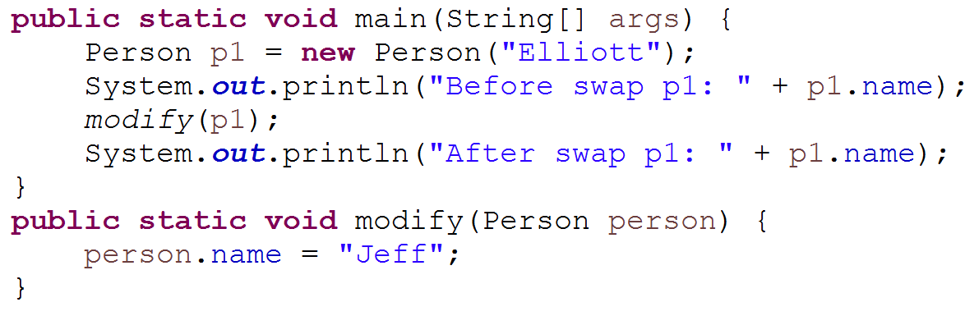
Example
Notes:
Yet we can still change variables within the object, just not the objects reference.
116

Slide 100
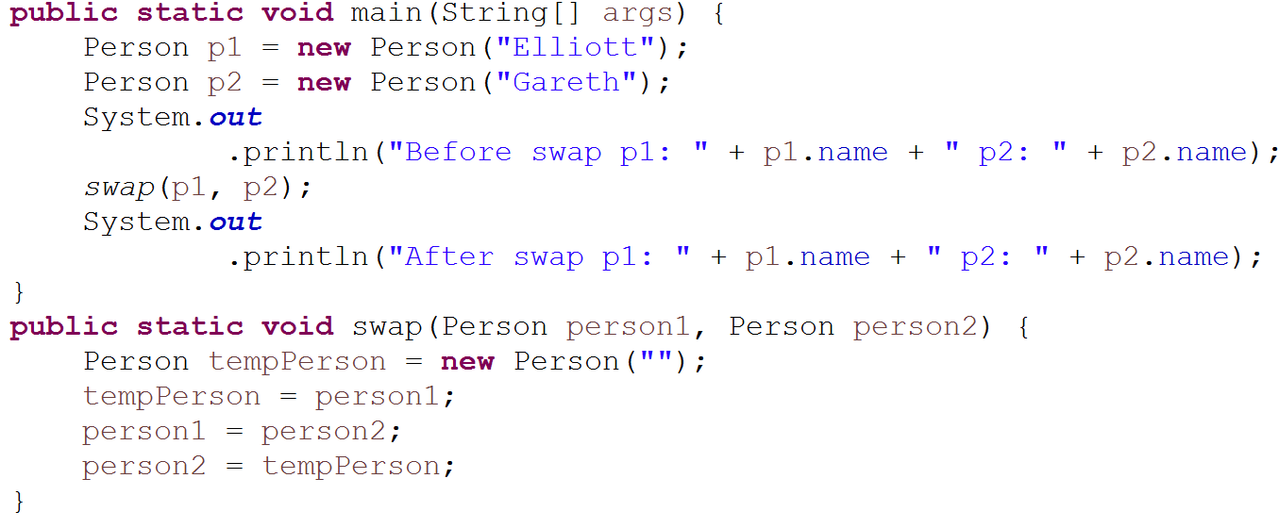

Example
Notes:
Before swap p1: Elliott p2: Gareth
After Swap p1: Elliott p2: Gareth
No change! Any changes to the reference that is passed to the method doesn’t reflect as it’s just a copy of the original reference, both point to the same place but
Probably a great place to draw that example, with the balloons and the pointers.
116

Slide 101
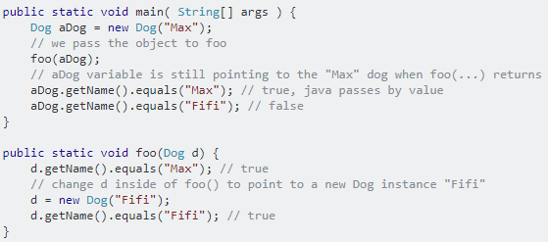
Example

Slide 102
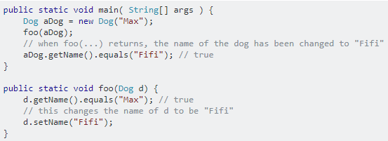
Example

Slide 103

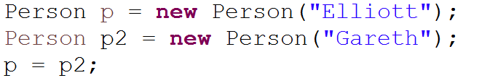
References & Garbage Collection
Garbage collection is where unreferenced objects are removed from memory
Javas Garbage collection is automatic, we don’t need to do it our self! (Big plus for Java!)
How can an object be unreferenced?
By setting objects reference to null.
By assigning the objects reference to another object
By using the object anonymously.

Slide 104
Object Reference Analogy
Balloon
“Object”
String
“Reference”
Object with a reference
Notes:
116

Slide 105
Object Reference Analogy
Garbage Collector
Pop!
Creating an Object
Un-Referencing the Object
Garbage Collected!
Notes:
Remember: You can have multiple references to an object, but as soon as the object has 0 references, it pops!
116

Slide 106
Casting
Casting is used to take data of one type and use it as another,
E.g.: casting floats to ints to remove the decimal.
Casting also becomes important in polymorphism where you have an array to hold everything of one object type but any object that inherits that object type can also be stored in the array so you can use casting to see what sub-type the object is.
You can check if an object is an instance of another by using the instanceof method.
double dbl = 104.4;
int i = (int)dbl;
//i equals 104, the .4 is truncated
if(vehicle1 instanceof Car)
//do stuff
Notes:
myGarage.listOfVehicles.get(0)
g1.vehicleArrayList.get(0).isTaxed();
Car testCar = (Car) g1.vehicleArrayList.get(0);
testCar.isTaxed();

Slide 107
Object Casting
An object of a derived class can be treated as an object of a base class without explicit casting (upcasting)
Base type reference must be explicitly cast to use as a derived type
Known as a downcast
class Shape {
...
}
class Ellipse extends Shape {
...
}
Shape s = getShapeFromPoint();
s.draw();
Ellipse e = (Ellipse) s;
float f = e.getCircumference();
Notes:
You can only invoke methods of the base type when working with a base type reference. For example, in the code above, the compiler will check to make sure that the method draw() is defined in the base Shape class. But what happens when you want to call a method that is defined in the derived class, such as the getCircumference() method, shown in the example, that is defined in Ellipse?
In this case, you will need to perform a downcast (a cast down the inheritance tree) using the standard casting syntax. This, of course is fraught with danger. What happens if the getShapeFromPoint() method (shown on the previous slide) returned a Shape reference that actually referenced a Rectangle or a Triangle object? The cast to Ellipse would fail as Ellipse is NOT a kind of Rectangle in our inheritance tree and the JVM would thrown an exception.
So, to summarise, it is always possible to use a base reference to refer to a derived object (and to implicitly convert a derived reference to a base reference, which is known as an upcast). Downcasts, however, require explicit casts and extra checking, which is what the operator instanceof provides, as shown on the next two pages.

Slide 108
Interface Classes
public abstract class Shape {
public abstract float getArea();
}
Interfaces cannot contain full code, only method stubs and final variables. Not true as of Java 8.
Every method is inherently abstract and public.
They are useful because whereas classes can only extend one class they can implement multiple classes
List interfaces after the base class (if any) via keyword implements
All members must be implemented
.
public interface Renderable {
void draw();
}
public class Rectangle extends Shape implements Renderable {
private int height;
private int width;
public void draw() {
...
}
public float getArea() {
get { return height * width; }
}
}
Notes:
Now every shape we create (Such as rectangle) doesn’t inherently need to have a draw() function, however we have the option of implementing that draw function by making the shape Renderable via implementing that appropriate interface class.

Slide 109
Interface – Example
class ManualCar implements GearBox {
public void changeGear(){
//change gear manually
}
}
interface GearBox {
void changeGear();
}
class AutomaticCar implements GearBox {
public void changeGear(){
//change gear automatically
}
}
Notes:
So every car has a gearbox, whilst some have automatic working ones and some have manual ones, they both need a way to change gears yet they do them differently, hence why we use an interface to do so.
116

Slide 110
Interface – What's the point?
Surely I could just write the methods if they're appropriate?
Why do I need to create a separate class to then tell me I need to write them?
Isn’t this the opposite of code re-use?
If the class has been written properly we know how we can use it based on the interfaces it implements.
Yes & No – Think of an electric outlet.
The interface for an electric outlet is exactly the same, 3 pins. (not strictly true but shh.)
Imagine a hypothetical interface called Pluggable , that means that it has a standard set of prongs that will plug into a standard outlet.
A Dog does not implement the Pluggable interface, so we know we cant plug a dog into an electrical outlet.
However a PS4 does implement the Pluggable interface, so we know we can plug it in.
Notes:
116

Slide 111
Interface – What's the point?
Encourages smart application design.
Promotes Readability
Promotes Maintainability
Allows flexibility
They will both have the same functionality
However by declaring it in the first example you constrain yourself to only use methods in ArrayList that List templates initially,
So any extra methods that ArrayList offers that List does not have a template for you cannot use
However you can in the second example.
List<String> strings = new ArrayList<String>();
ArrayList<String> strings = new ArrayList<String>();
Notes:
The benefit of this is that there are loads of different types of Lists that all implement the same functions differently, so if later down the line you realise your code didn’t need to use ArrayList but instead could use LinkedList you can simply switch your variable initliazation to LinkedList and your code would still work, however if you declared your list in the second example you would (depending on if you’ve used any of the extra methods) have to go through and change your code.
This is called coding to an interface
<number>

Slide 112
Interface – Benefits of coding to an interface
One of the major benefits of using interfaces is how you can link multiple seemingly unrelated objects together with them
Take the two objects Apple and Pen. Nothing really related about them, can’t have a common parent class or anything. (Like Animal was)
If we wanted to create a method that performs a similar function on both of them, we’d have to have one for each type.
But with an interface, that could be the common factor!
class Apple {
double weight = 40.3;
public void output() {
System.out.println(weight);
}
}
class Pen {
String brand = "Byro";
public void output() {
System.out.println(brand);
}
}
Notes:
Both of these classes want a way to output their contents, how could we do this via one method? Usually you’d have a super class like Animal that might contain the output method that you could override, but for two objects that aren’t related at all? Hmm..
<number>

Slide 113
Interface – Benefits of coding to an Interface
interface Info {
public void output();
}
class Apple implements Info {
double weight = 40.3;
public void output() {
System.out.println(weight);
}
}
class Pen implements Info {
String brand = "Byro";
public void output() {
System.out.println(brand);
}
}
Now that this method is in an interface, and our classes are implementing that interface, they have some sort of contract they are both adhering too.
We can use this as our common factor!

Slide 114
Interface – Benefits of coding to an Interface
Since they both conform to the Info interface, you can actually use them as a type that will give you access to the objects implementation of the methods in that interface!
You can also declare objects like so! It will be pointing to an Apple object, but only provide access to the methods belonging in “Info” (As well as Object, since everything inherits from object!)
public static void main(String[] args)
{
Apple a = new Apple();
Pen p = new Pen();
outputInfo(a);
outputInfo(p);
}
private static void outputInfo(Info i) {
i.output();
}
Info i = new Apple();
i.output();

Slide 115

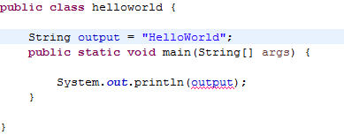
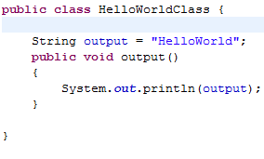

Static – Why is it telling me I can’t do this?
Something you’ve probably all come across when starting java, or soon will.
Notes:
No, the answer isn’t to just make the variable static, whilst that would make the code work it is not the right way to go about it most of the time.
For simple programs you can put the variables/method code in main
But for a bigger project everything should be separated into classes that the main method would create as objects and then use through that instance.

Slide 116
Static – When would we use this?
When we create a class and make a variable static it means that only one instance of the static field exists.
Even if you create a million instances of that class there will only be one instance of that static field
Why do we use these?
Just ask yourself, does it make sense to call this method or variable, even if no Object has been created yet? If so, it should probably be static.
An example of using static would be in an Object called Student
In Student we have a variable called Count
Count represents how many Students have been created so far
We don’t need an individual count variable every time we create a student
So by making it a static variable, it means there’s only one of the count variable, that we can increment/decrement/use.

